Slide 1
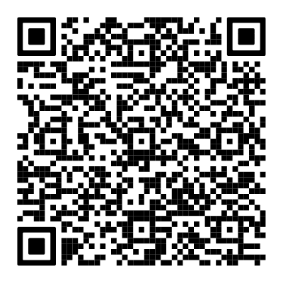

Register your vote now!
Scan the QR Code and make your choice
Results page

Slide 2

What if I told you that the game was made with the VddddddIO?

Slide 3
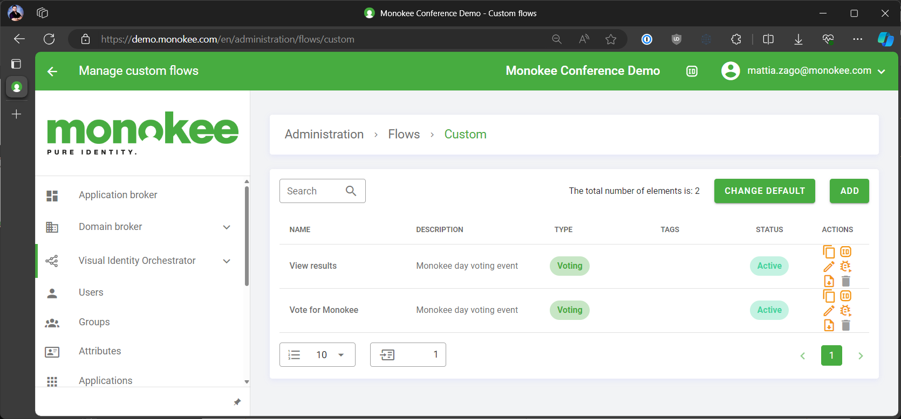
A game made with an orchestrator? That’s correct!

Slide 4
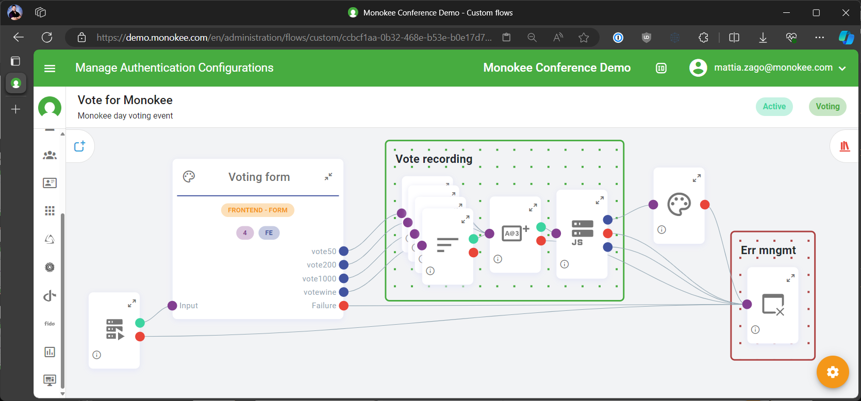
Voting flow

Slide 5
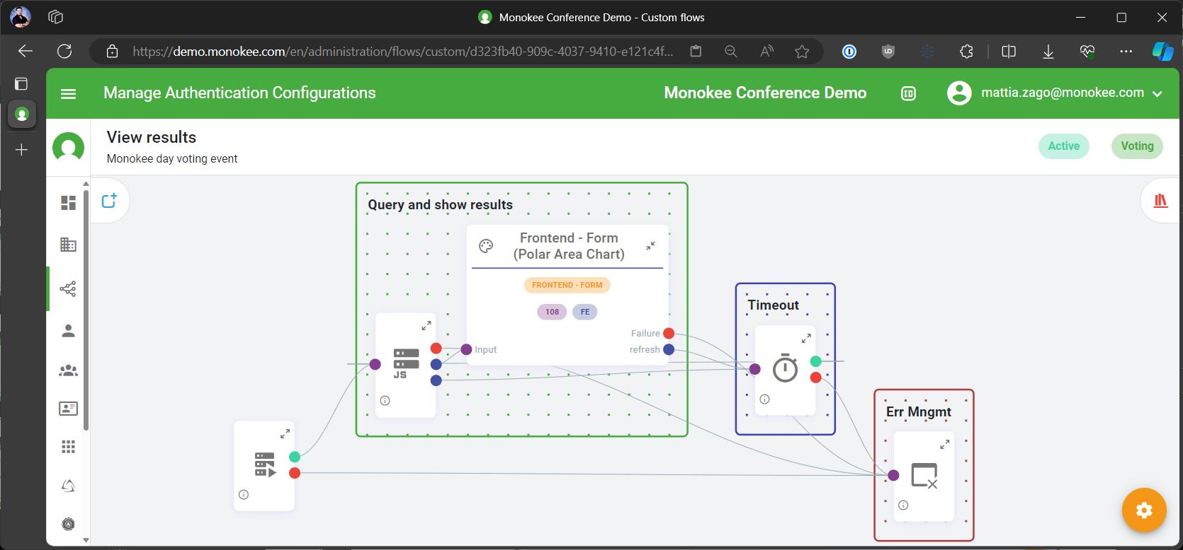
View results flow

